Slide 1
Dashboard Background Design Methods

Slide 2
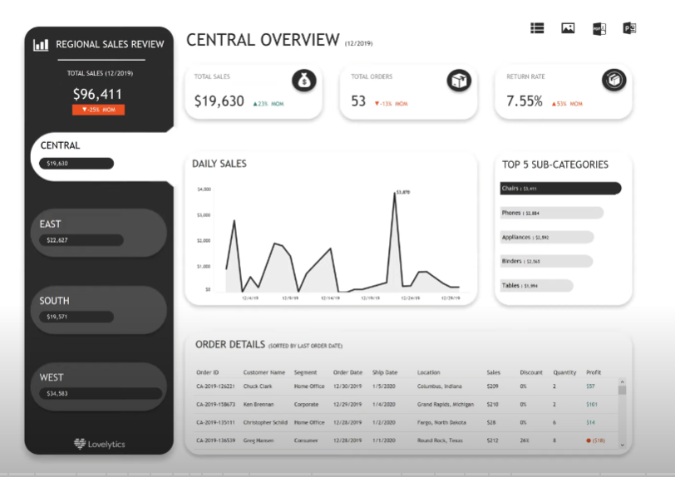

Slide 3
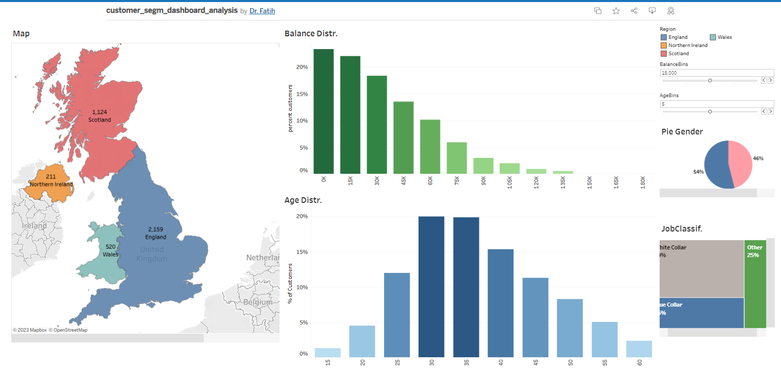

Slide 4
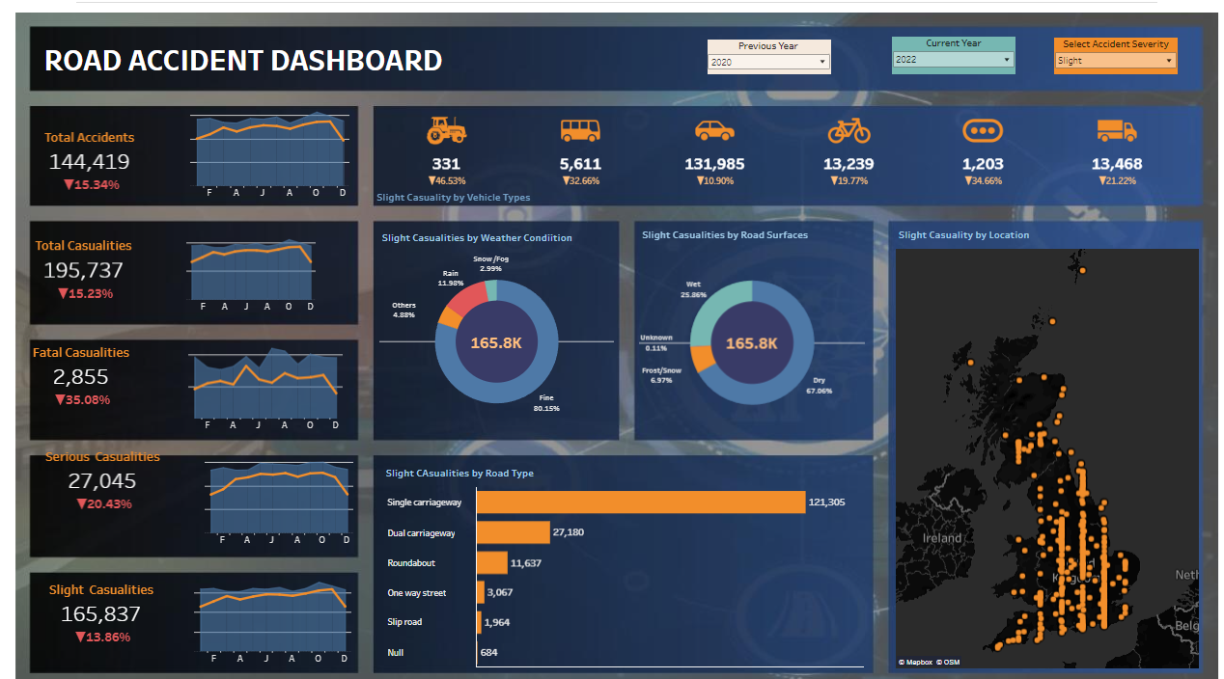

Slide 5
Dashboard Background Design
El ile çizim
Figma
Canva
Power Point
Sketchwow
AutoCAD
Tableau
Power BI
Qlik
Excel

Slide 6
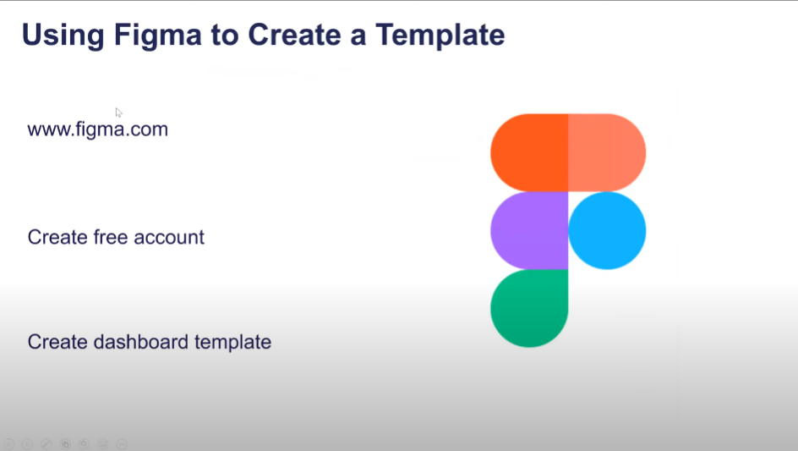

Slide 7


Slide 11
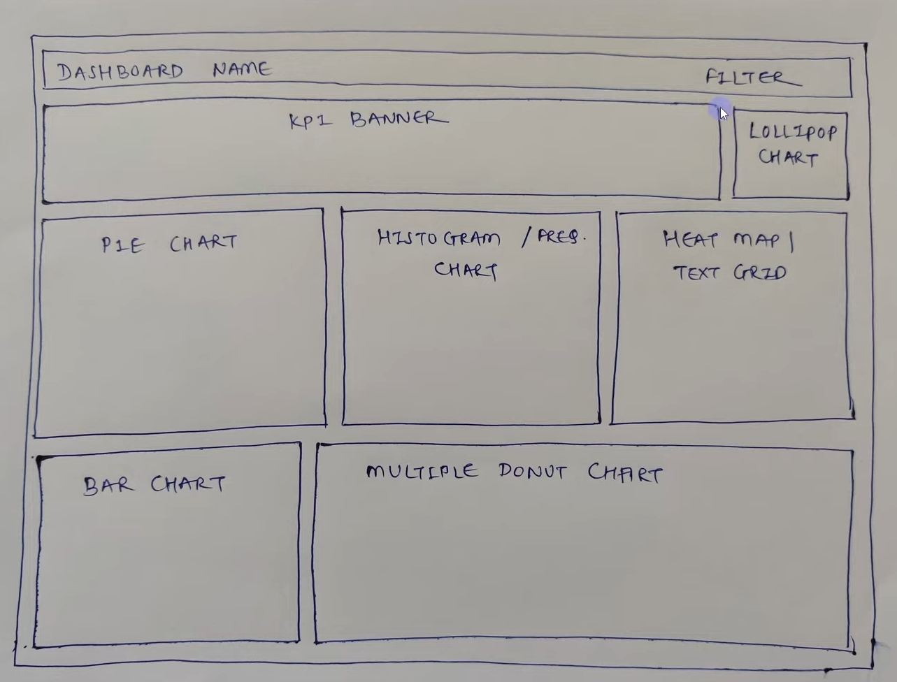

Slide 12


